Slide 1
How to Migrate Gmail to Microsoft Office 365
Step 1
Create a CSV File: Open Microsoft Excel and create three columns “EmailAddress”, “UserName” and “Password”. If you want to migrate single account then enter single account details and if you want to migrate multiple then enter multiple accounts details in each column.

Slide 2
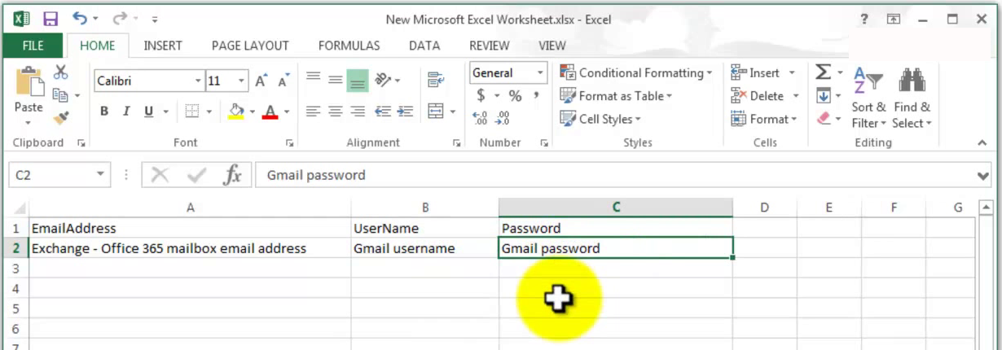
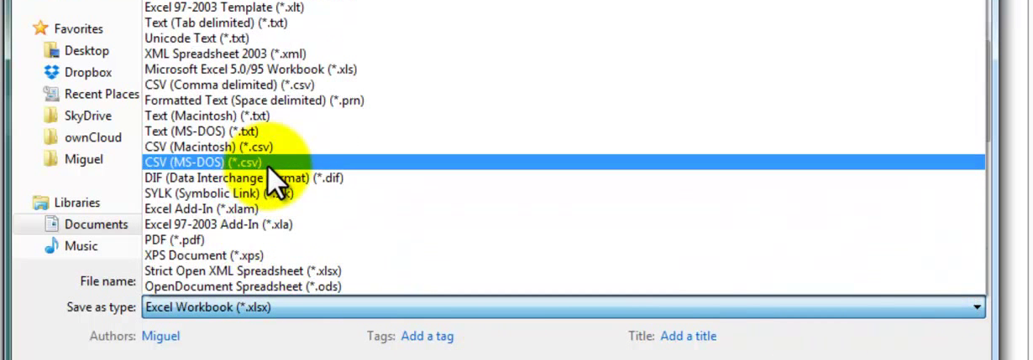
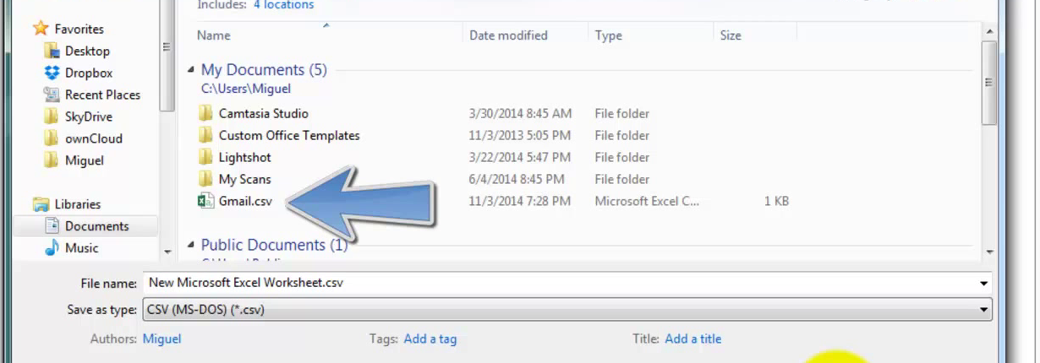

Slide 3
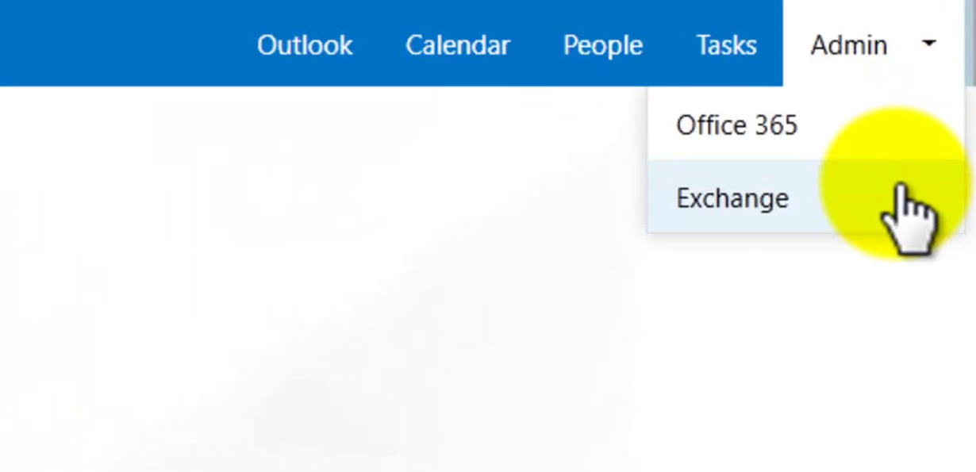
Step 2
Go to Microsoft Office 365 “Admin Panel” and select “Exchange” under the admin link.

Slide 4
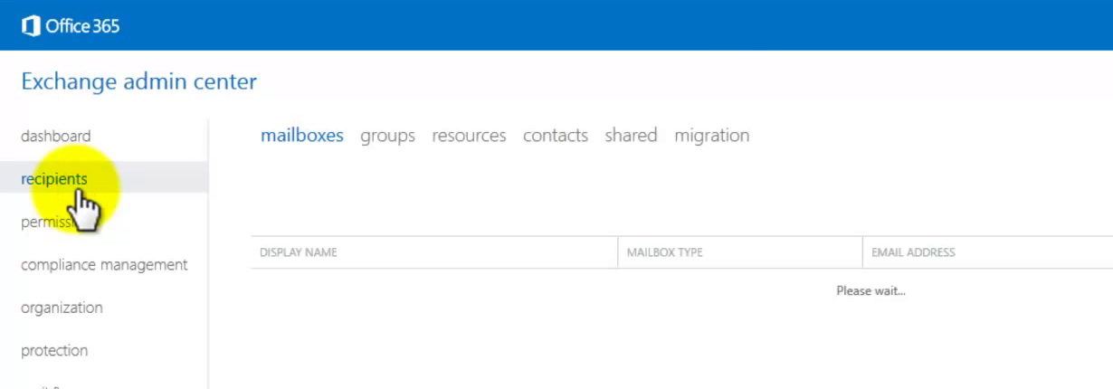
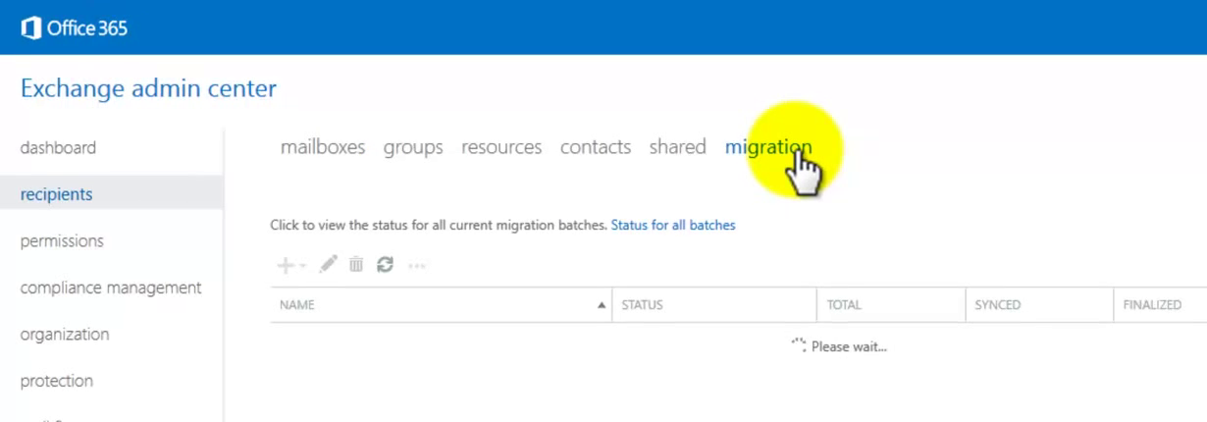
Step 3
Click on “Recipient” on the left side and click on “Migration” link.

Slide 5
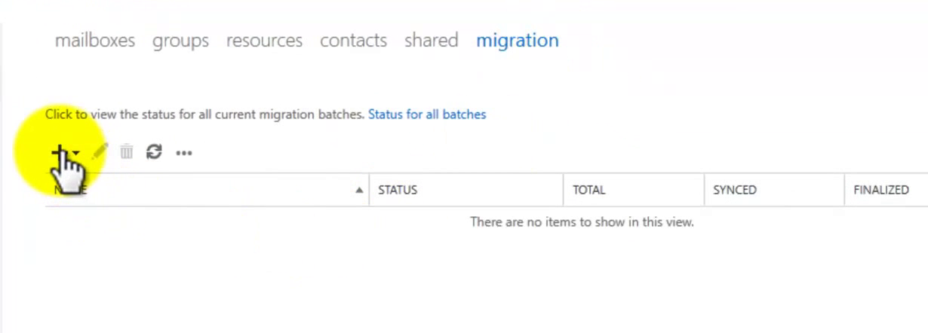
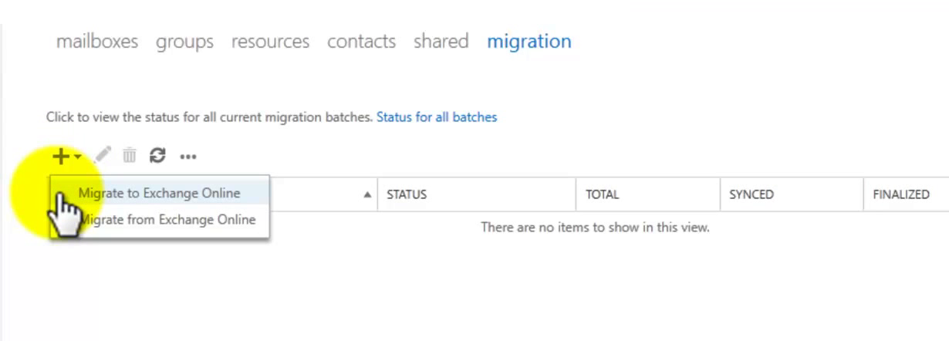
Step 4
Click on the “+” symbol and select “Migrate to Exchange Online”.

Slide 6
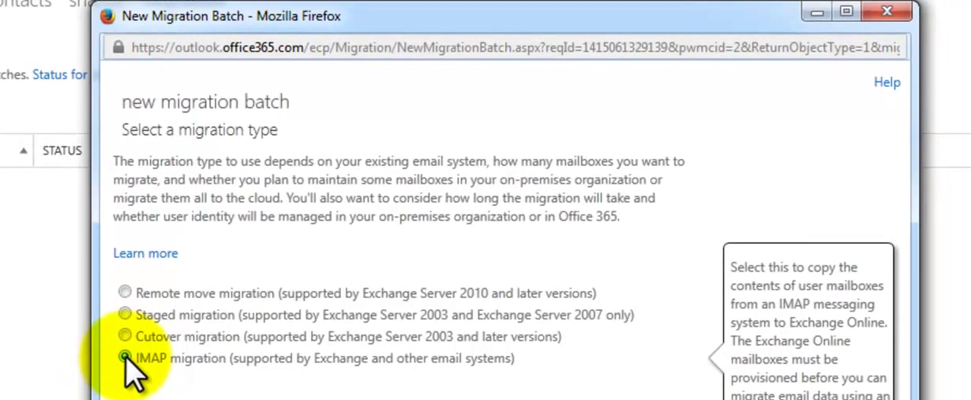
Step 5
Select “IMAP migration” and then brows for the CSV file that has been created earlier.

Slide 7
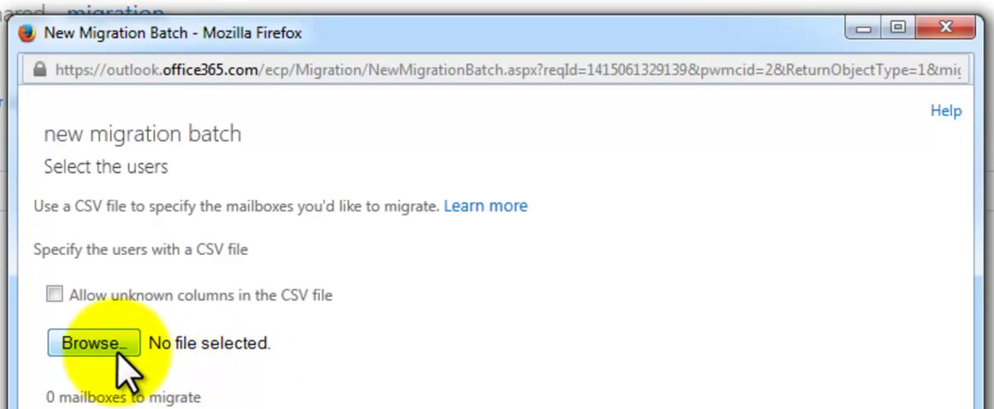
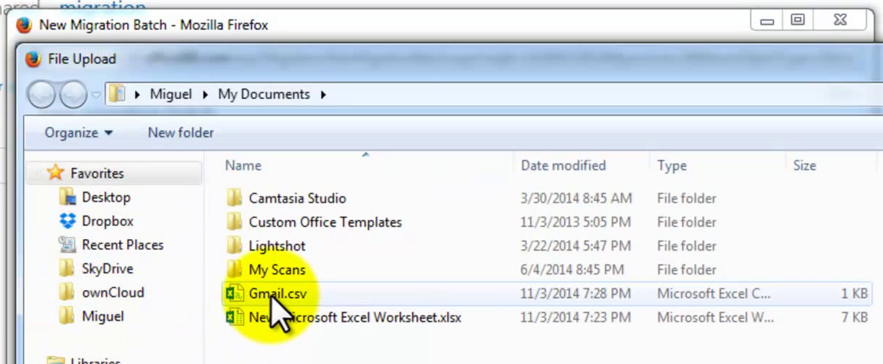
Step 5

Slide 8
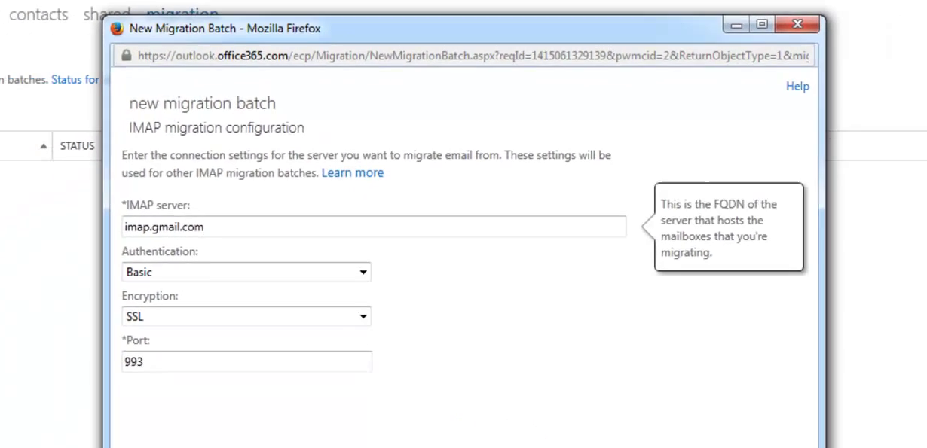
Step 6
Click “Next” and enter the “IMAP server” (if it is Gmail enter “imap.gmail.com” and it will automatically fill the Authentication, Encryption and Port number.)

Slide 9
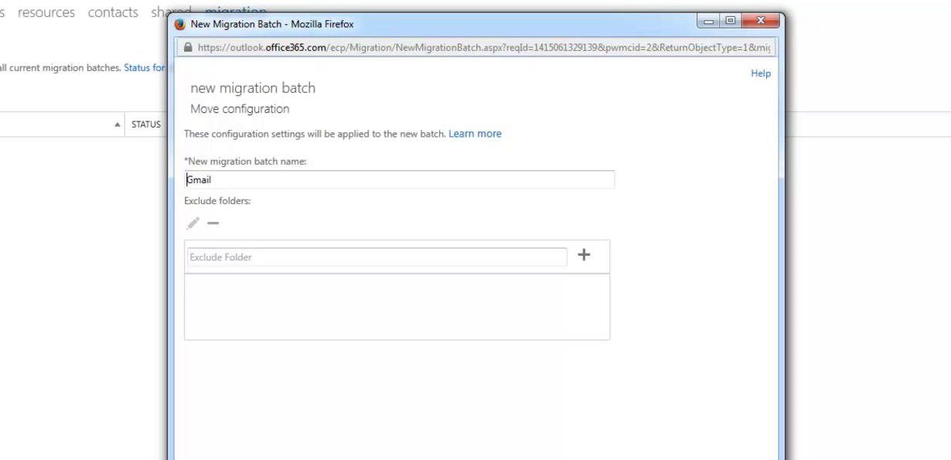
Step 7
Click “Next” and here you can rename your migration batch name or leave it for default

Slide 10
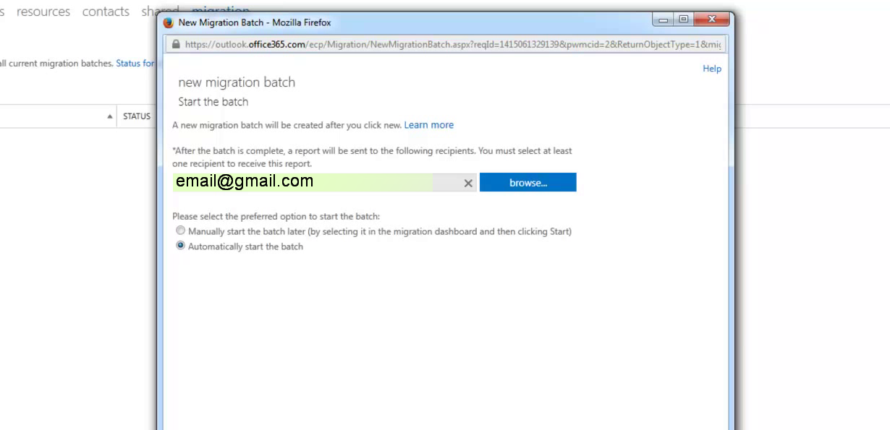
Step 8
Now you will see the email or emails list that are going to be migrated.

Slide 11
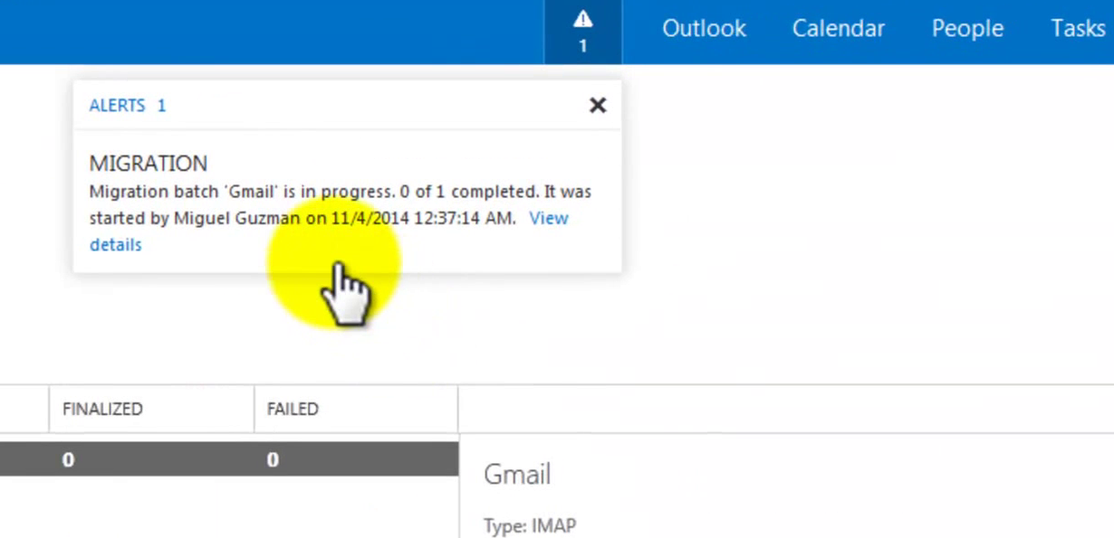
Step 9
Now after clicking the next button you will see a “Popup/Alert” informing the migration batch is in process.

Slide 12
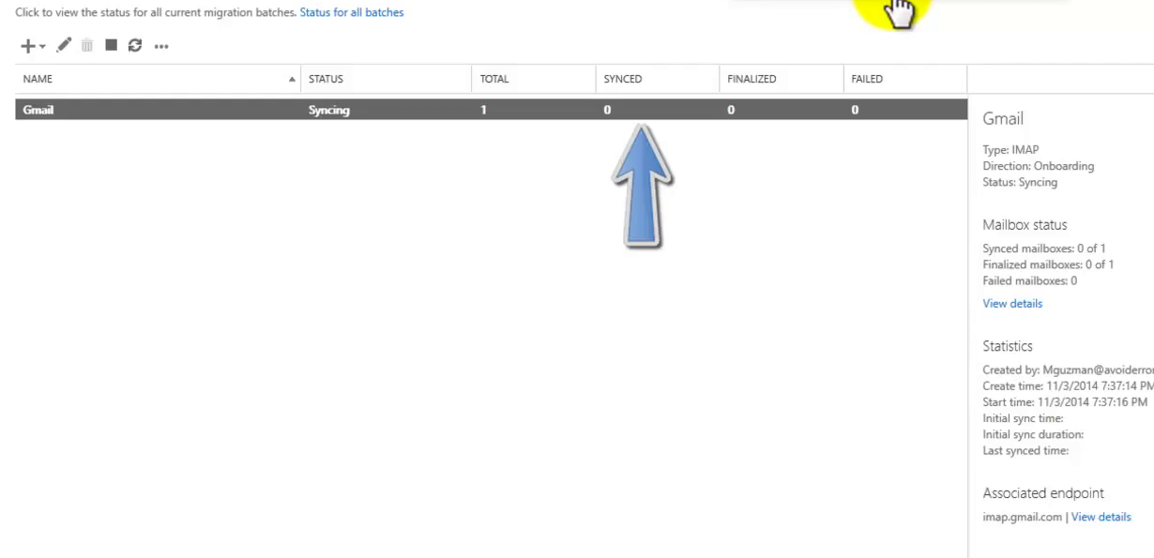
Step 10
As soon as the migration process has been finished it will tell that is synced and send an email.

